Slide 1
Powerplays and Predictions: Unlocking IPL Intelligence Submission 03: Advanced IPL Match Analysis and Prediction with PyTorch
Ashwin Paturi, Akarsh Lakshmana, Divakar Ravi, Sara Verkiyani
Team Number 09 Major - MSCS
CS506 Spring 2025

Slide 2
Agenda
Overview
Why PyTorch?
PyTorch vs Scikit Learn
Dataset Overview
Features and Target
Pytorch Components used
Data Pipeline Overview
Model Architecture and Summary
Training Metrics and Evaluation
AUC-ROC Curve
Key learnings

Slide 3
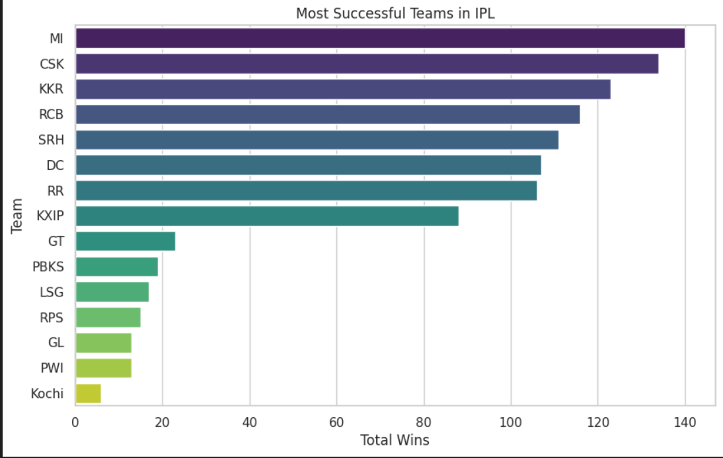
Overview
Use of PyTorch for deep learning modeling
Predict match winners using match metadata
Trained on structured features from the previous modules.

Slide 4

Why PyTorch?
Flexible and Pythonic deep learning framework
Supports dynamic computation graphs
Essential for scalable, custom neural models
Community and academic-friendly ecosystem

Slide 5
PyTorch vs Scikit Learn
Scikit-learn: - Simpler, high-level API - Works well for traditional ML models PyTorch: - Lower-level, dynamic graph computation - Full control over model architecture and training loop - Ideal for deep learning models and custom pipelines

Slide 6
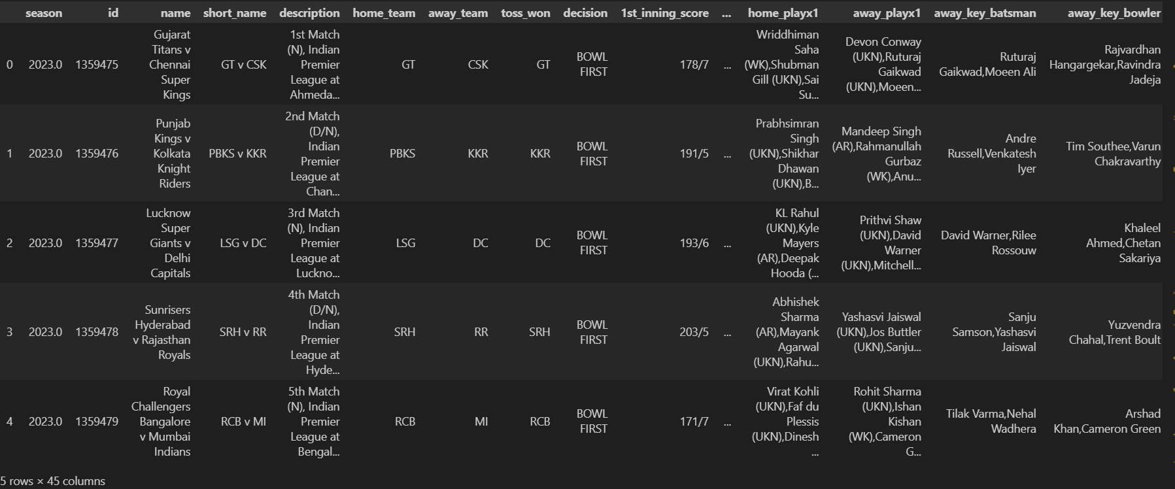
Dataset Overview
Dataset used from previous modules
Categorical columns encoded: teams, venues, toss info
Target: Match winner
Cleaned and preprocessed using Pandas & Scikit-learn

Slide 7
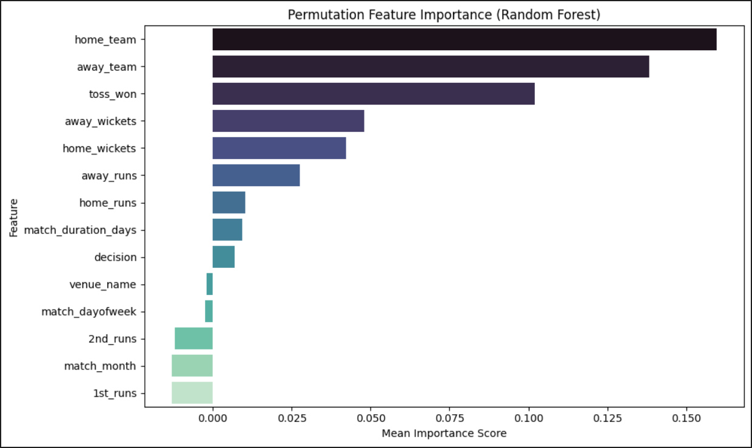
Features and Target
Input Features: home_team, away_team, venue_name, toss_won, decision
All categorical → Label Encoded
Scaled using StandardScaler
Target: winner (multi-class classification)

Slide 8

PyTorch Components Used
Tensors and Tensor Operations
Custom Dataset and DataLoader
Neural Network using nn.Module
CrossEntropyLoss and Adam optimizer
Training loop with autograd for backpropagation

Slide 9
Data Pipeline Overview
Read and clean the IPL dataset using Pandas
Select key categorical features for prediction
Encode features and target using LabelEncoder
Scale features using StandardScaler
Split into train/test sets
Load into PyTorch DataLoader via custom Dataset
Train and evaluate a neural network model

Slide 10
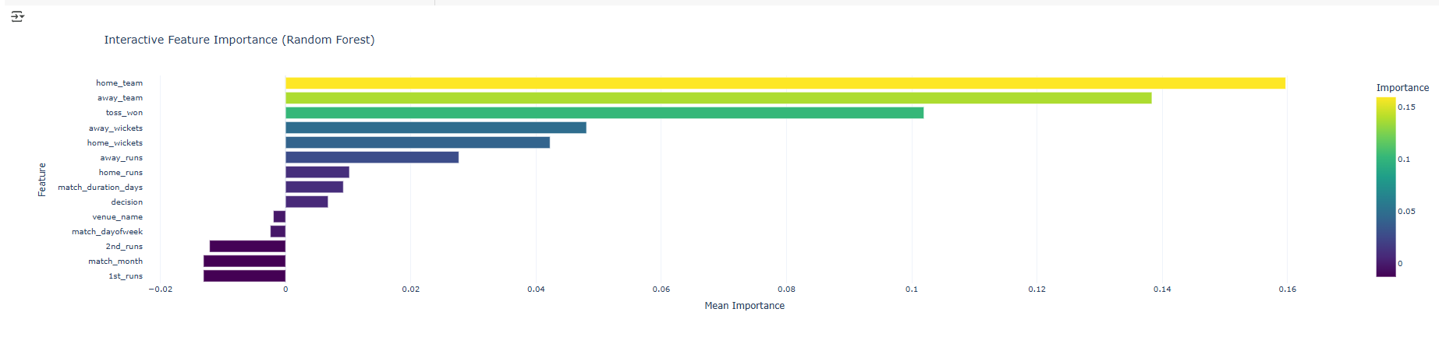
Data Pipeline Overview

Slide 11
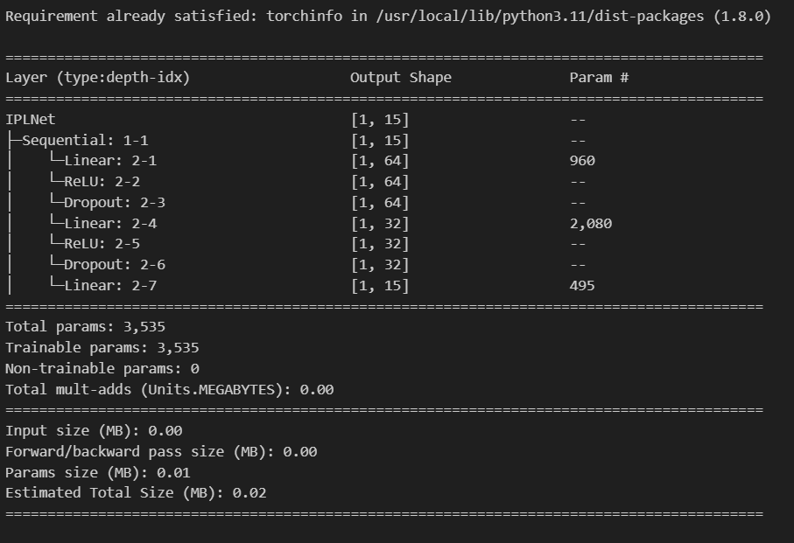
Model Architecture
IPLNet: 3-layer feedforward network:
Input Layer → 64 neurons → ReLU
Hidden Layer → 32 neurons → ReLU
Output Layer → Softmax over classes
Optimizer: Adam, Learning Rate = 0.001
Loss Function: CrossEntropyLoss

Slide 12
Model Summary
Used torchinfo.summary() for PyTorch model analysis.
Displays input/output shapes and total parameters.
Validated architecture from input (16) to output (8 classes).
Useful for structural debugging and model transparency.

Slide 13
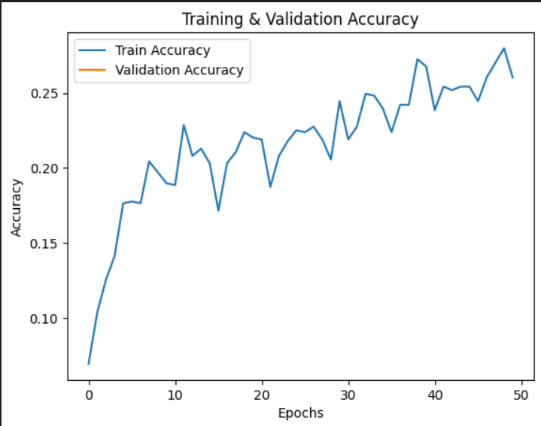
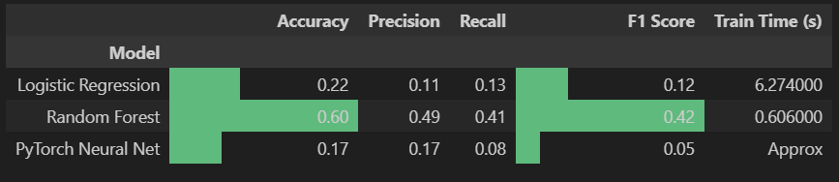
Training Configuration
Batch size: 32
Epochs: 20
Train/Test Split: 80/20
Model trained on GPU (if available)

Slide 14
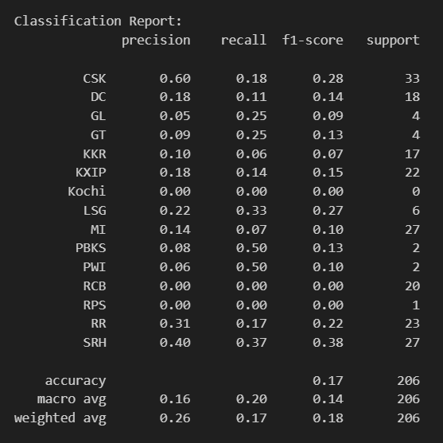
Evaluation Metrics
Accuracy on the test set
Training loss curve plotted
Encouraging results with a simple neural net.
Future: Use advanced architectures and embeddings

Slide 15
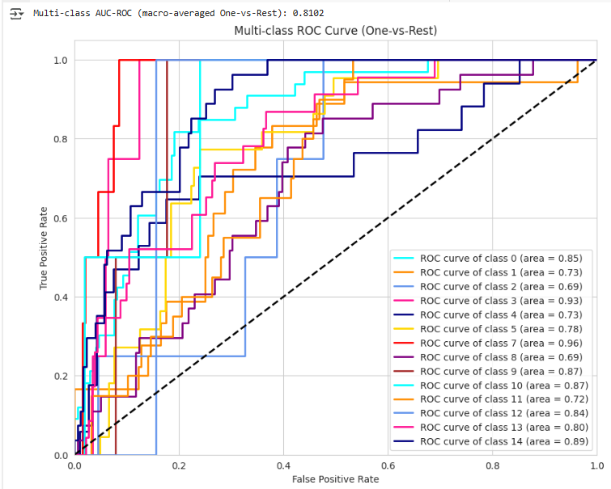
Multi-Class AUC-ROC Evaluation
ROC-AUC is used to evaluate the performance of multi-class classification.
One-vs-Rest strategy with softmax outputs.
Helpful in understanding per-class prediction confidence.
Complements accuracy by evaluating discriminatory power across classes.

Slide 16
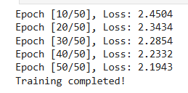
Cross Entropy Loss
Combines LogSoftmax + Negative Log Likelihood
Ideal for multi-class classification
Compares raw output logits against the true class index
Encourages confident predictions for the correct class
Used widely in classification tasks like NLP, Vision, etc.

Slide 17
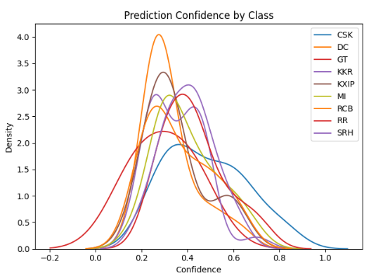
Visual Insights
The training loss curve indicates that the model is converging.
ROC curves plotted per team for performance clarity.
Charts enhance the interpretability of multi-class classification results.
Visual feedback aligns with evaluation metrics.

Slide 18
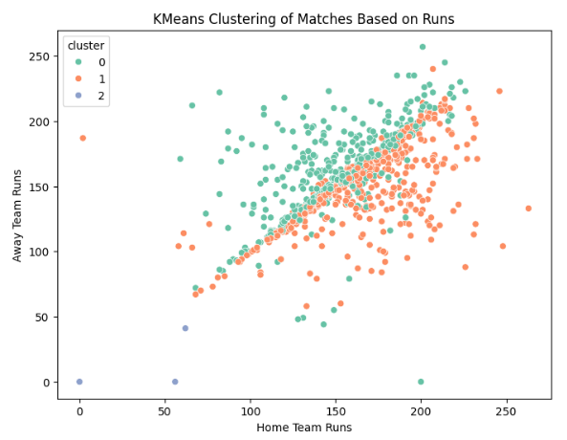
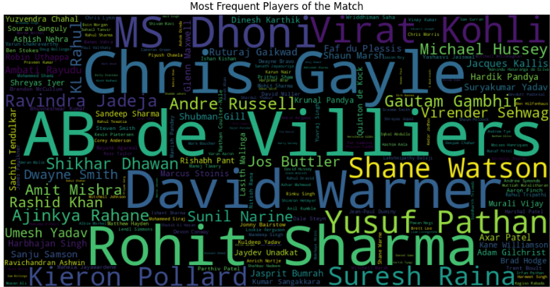
Visual Insights
Most POTMs Word Cloud
K-Means Clustering of Batting Percentage

Slide 19
Key Learnings
End-to-end modeling using PyTorch
Conversion of structured sports data to tensors
Importance of encoding, scaling, and batching
How model complexity affects performance

Slide 20
Project Takeaways
Completed full analytics pipeline from all the modules.
Demonstrated deep learning on structured sports data.
Evolved evaluation from accuracy to multi-class ROC-AUC.
Framework adaptable to real-time match prediction use cases.

Slide 21
Future Work
Hyperparameter tuning and cross-validation
Use embeddings for categorical variables
Ensemble models or deeper networks
Integrate temporal or player-specific data

Slide 22


Q&A

